Slide 1
Introduction to the Internet and Web
Adapted from: grail.cba.csuohio.edu/~sanchita/ist203/classnotes/Internet.ppt

Slide 2
Internet
It is the largest network in the world that connects hundreds of thousands of individual networks all over the world.
The popular term for the Internet is the “information highway”.
Rather than moving through geographical space, it moves your ideas and information through cyberspace – the space of electronic movement of ideas and information.

Slide 3
The uses of the Internet
Send e-mail messages.
Send (upload) or receive (down load) files between computers.
Participate in discussion groups, such as mailing lists and newsgroups.
Surfing the web.

Slide 4
What is Web?
The Web (World Wide Web) consists of information organized into Web pages containing text and graphic images.
It contains hypertext links, or highlighted keywords and images that lead to related information.
A collection of linked Web pages that has a common theme or focus is called a Web site.
The main page that all of the pages on a particular Web site are organized around and link back to is called the site’s home page.

Slide 5
How to access the Web?
Once you have your Internet connection, then you need special software called a browser to access the Web.
Web browsers are used to connect you to remote computers, open and transfer files, display text and images.
Web browsers are specialized programs.
Examples of Web browser: Google chrome, Safari, Mozilla and Internet Explorer.

Slide 6
Client/Server Structure of the Web
Web is a collection of files that reside on computers, called Web servers, that are located all over the world and are connected to each other through the Internet.
When you use your Internet connection to become part of the Web, your computer becomes a Web client in a worldwide client/server network.
A Web browser is the software that you run on your computer to make it work as a web client.

Slide 7
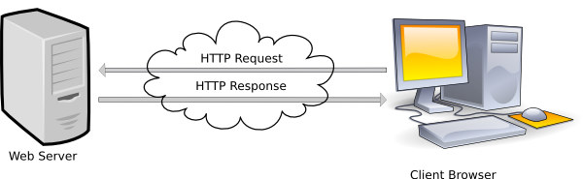
Web server client architecture
Credit: https://www.csee.umbc.edu/~dondim1/104/powerpoint/L06IntroToWebHTML.ppt

Slide 8
Hypertext Markup Language (HTML)
The public files on the web servers are ordinary text files, much like the files used by word-processing software.
To allow Web browser software to read them, the text must be formatted according to a generally accepted standard.
The standard used on the web is Hypertext markup language (HTML).

Slide 9
Hypertext Markup Language (HTML)
HTML uses codes, or tags, to tell the Web browser software how to display the text contained in the document.
For example, a Web browser reading the following line of text:
<B> A Review of the Book<I>Wind Instruments of the 18th Century</I></B>
recognizes the <B> and </B> tags as instructions to display the entire line of text in bold and the <I> and </I> tags as instructions to display the text enclosed by those tags in italics.

Slide 10
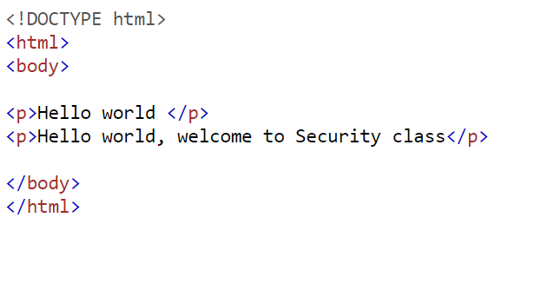
HTML: example

Slide 11
Addresses on the Web:IP Addressing
Each computer on the internet does have a unique identification number, called an IP (Internet Protocol) address.
The IP addressing system currently in use on the Internet uses a four-part number.
Each part of the address is a number ranging from 0 to 255, and each part is separated from the previous part by period,
For example, 106.29.242.17

Slide 12
IP Addressing
The combination of the four IP address parts provides 4.2 billion possible addresses (256 x 256 x 256 x 256).
This number seemed adequate until 1998.
Members of various Internet task forces are working to develop an alternate addressing system that will accommodate the projected growth.
However, all of their working solutions require extensive hardware and software changes throughout the Internet.

Slide 13
Domain Name Addressing
Most web browsers do not use the IP address to locate Web sites and individual pages.
They use domain name addressing.
A domain name is a unique name associated with a specific IP address by a program that runs on an Internet host computer.
This program, which coordinates the IP addresses and domain names for all computers attached to it, is called DNS (Domain Name System ) software.
The host computer that runs this software is called a domain name server.

Slide 14
Domain Name Addressing
Domain names can include any number of parts separated by periods, however most domain names currently in use have only three or four parts.
Domain names follow hierarchical model that you can follow from top to bottom if you read the name from the right to the left.
For example, the domain name gsb.uchicago.edu is the computer connected to the Internet at the Graduate School of Business (gsb), which is an academic unit of the University of Chicago (uchicago), which is an educational institution (edu).
No other computer on the Internet has the same domain name.

Slide 15
Uniform Resource Locators
The IP address and the domain name each identify a particular computer on the Internet.
However, they do not indicate where a Web page’s HTML document resides on that computer.
To identify a Web pages exact location, Web browsers rely on Uniform Resource Locator (URL).
URL is a four-part addressing scheme that tells the Web browser:
What transfer protocol to use for transporting the file
The domain name of the computer on which the file resides
The pathname of the folder or directory on the computer on which the file resides
The name of the file

Slide 16
Structure of a Uniform Resource Locators
pathname
protocol
http://www.chicagosymphony.org/civicconcerts/index.htm
Domain name
filename
http => Hypertext Transfer Protocol

Slide 17
HTTP
The transfer protocol is the set of rules that the computers use to move files from one computer to another on the Internet.
The most common transfer protocol used on the Internet is the Hypertext Transfer Protocol (HTTP).
Two other protocols that you can use on the Internet are the File Transfer Protocol (FTP) and the Telnet Protocol

